Slide 1

Contract Monthly Claim System (CMCS)
Part 3: Automation & Database Integration
Jeron Okkers| ST10447759| PROG6212

Slide 2

Overview: Streamlining Contractor Claims
The Contract Monthly Claim System (CMCS) is a web-based application meticulously designed to streamline the entire claim submission process for independent contractors. This presentation focuses on Part 3, where we elevate the system from a static prototype to a fully functional, database-driven solution.
Part 3 Focus
Key Objectives
Transitioning from a static prototype to a dynamic, database-driven application.
Data Persistence (SQL Server)
Role-Based Security (HR, Lecturer, Coordinator, Manager)
Process Automation (Calculations & Validations)

Slide 3

Enhancements: From Limitations to Solutions
Significant improvements have been made to address previous limitations, enhancing data integrity and user management.
Part 2 Limitations
Part 3 Solutions
Data Storage: In-memory lists meant data was lost on restart.
SQL Server & Entity Framework Core: Ensures persistent and reliable data storage.
User Identity: Hardcoded user simulation lacked real-world security.
ASP.NET Identity: Provides secure login/logout and robust role-based access control.
Rate Management: Lecturers could manually type their rates, posing a risk of fraud.
HR Automation: Hourly rates are pulled securely from the database, non-editable by lecturers.

Slide 4

Technical Architecture: Foundation of CMCS
The CMCS is built on a modern, robust technology stack, ensuring scalability, security, and maintainability.
Framework
Database
ASP.NET Core MVC (.NET 8.0) for a high-performance web application.
SQL Server LocalDB for reliable and persistent data storage.
ORM
Authentication
Entity Framework Core, employing a Code-First approach for database interactions.
Microsoft.AspNetCore.Identity for secure user management and access control.
Frontend
Security
Razor Views, Bootstrap 5, and jQuery for a responsive and interactive user interface.
[Authorize] attributes on Controllers to enforce granular role-based access.

Slide 5
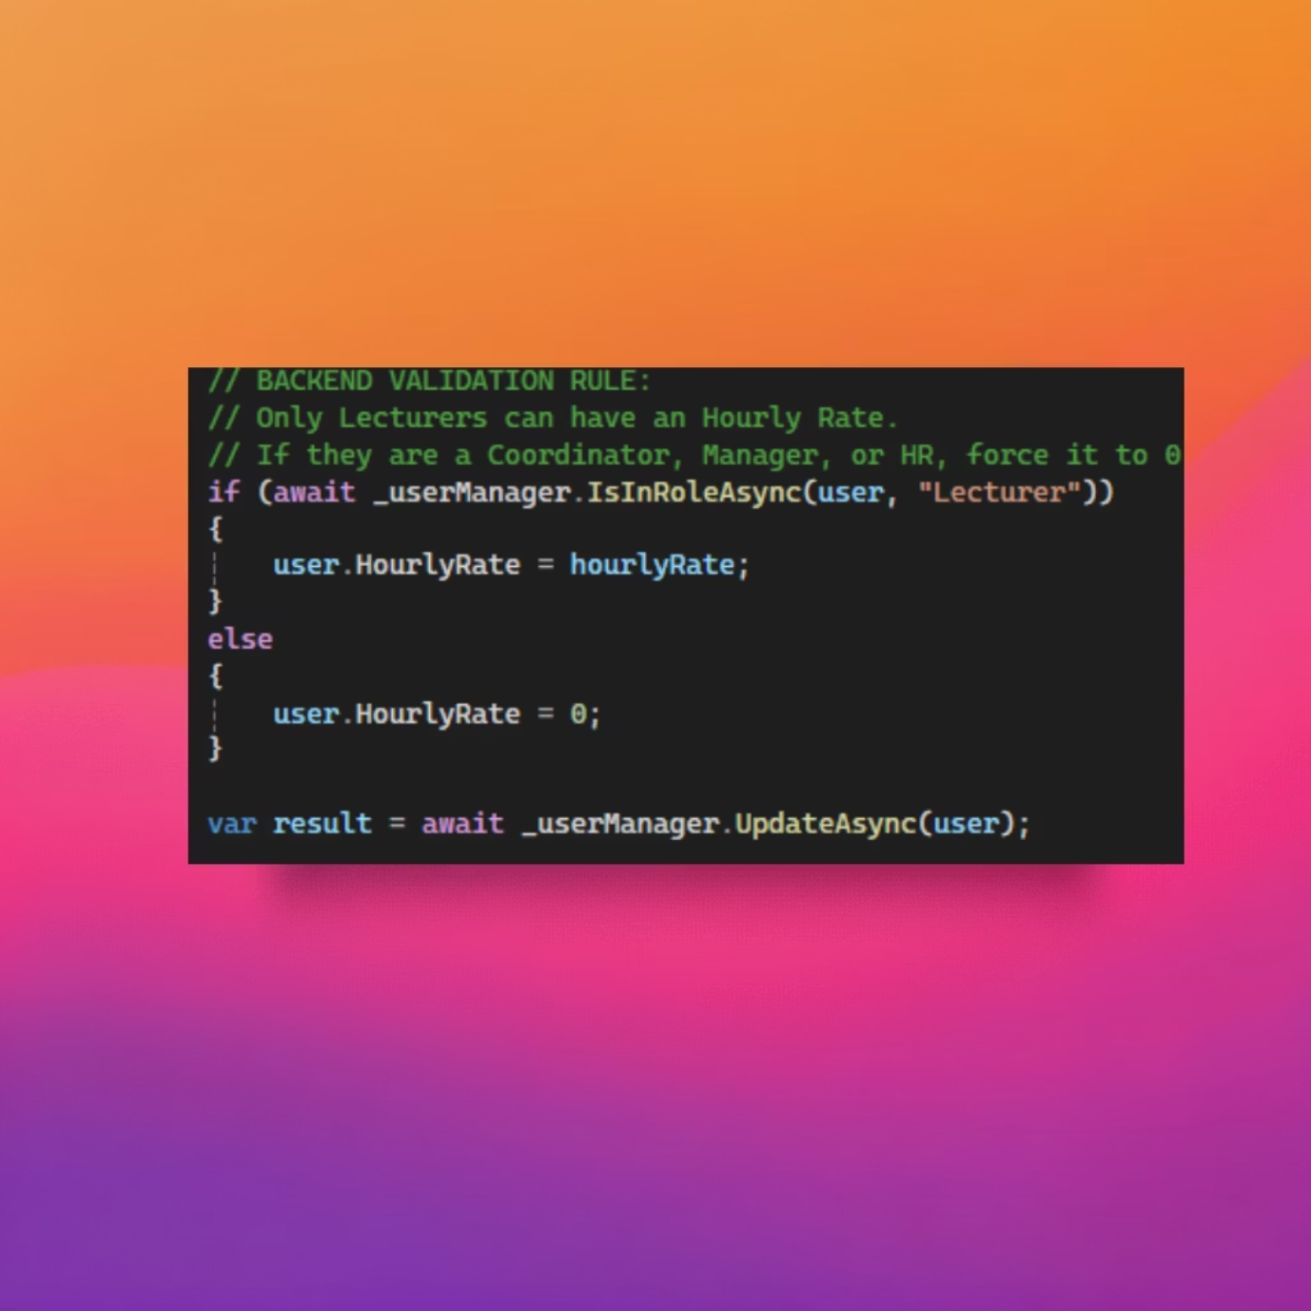
HR "Super User": Automation & Security
The HR "Super User" functionality ensures stringent control over user management and hourly rates, critical for preventing payroll discrepancies.
Key Feature 1: HR Automation & User Management
Requirement: HR must create users and strictly control hourly rates to ensure fairness and compliance.
Logic: During the update process, the system verifies the user's role. If the user is not a Lecturer, their HourlyRate is forcibly set to 0 in the backend.
Benefit: This prevents Coordinators or Managers from accidentally claiming rates and upholds data integrity, eliminating potential payroll errors.

Slide 6

Lecturer Automation: Claims & Validation
Automated claim processing for lecturers streamlines submissions while enforcing critical business rules.
Key Feature 2: Automated Claims & Validation
Auto-Calculation: The controller securely retrieves the HourlyRate directly from the database (user.HourlyRate), ignoring any form input to prevent tampering.
Validation: A business rule is applied to check if model.HoursWorked exceeds 180, rejecting claims that breach the monthly limit.
Benefit: This eliminates manual input errors and automatically enforces company policy, ensuring compliance and accuracy.

Slide 7

User Experience: Real-time Feedback
Enhancing the user experience through client-side automation provides immediate feedback and prevents common errors.
Key Feature 3: User Experience (UX) Automation
Real-time Feedback: Utilized jQuery to listen for input changes on the "Hours Worked" field, instantly calculating and displaying the total payout.
UI/UX: The Hourly Rate field is set to readonly, ensuring it cannot be manually altered. Users receive immediate feedback on their potential earnings without requiring form submission.
Benefit: Improves user satisfaction and reduces submission errors by providing transparent, instant calculations.

Slide 8

Reporting: Professional Invoices & Auditing
The system provides a robust reporting feature for HR, enabling the generation of clean, professional PDF reports for approved claims.
Key Feature 4: Reporting & Invoices
Requirement: HR needs to generate standardized PDF reports for all approved claims for auditing and record-keeping.
Solution: A dedicated "Approved Claims" view leverages CSS Media Queries (@media print) to remove non-essential elements like sidebars, navigation, and buttons when printing.
Benefit: This allows the browser's native "Save as PDF" functionality to produce a clean, professional invoice without the need for complex external libraries, simplifying report generation.

Slide 9

Conclusion: A Robust & Automated System
The CMCS has evolved into a secure, robust, and highly automated web application, addressing critical needs for contractor claim management.
Secure & Robust
Ensuring data integrity and user authentication with advanced security features.
Automated Workflows
Streamlining claim submissions, calculations, and policy enforcement.
Clear Separation of Concerns
HR for data, Lecturers for claims, and Admin for approvals.
Production-Ready
Database and Identity integration confirm the system's readiness for deployment.

Slide 10

Thank You!
Questions & Discussion
We appreciate your attention and welcome any questions or further discussion regarding the Contract Monthly Claim System.

